Slide 1




ICS Security - Basics
Made possible through support from the National Science Foundation (NSF) award number 1800929

Slide 2
Objectives
Summarize the history and purpose of industrial network protocols.
Discuss the basics and security concerns associated with Modbus TCP/IP.
Discuss the basics and security concerns associated with PROFINET/S7.
Discuss the basics and security concerns associated with Ethernet/IP.
Utilize common security tools to examine industrial protocols in action.

Slide 3
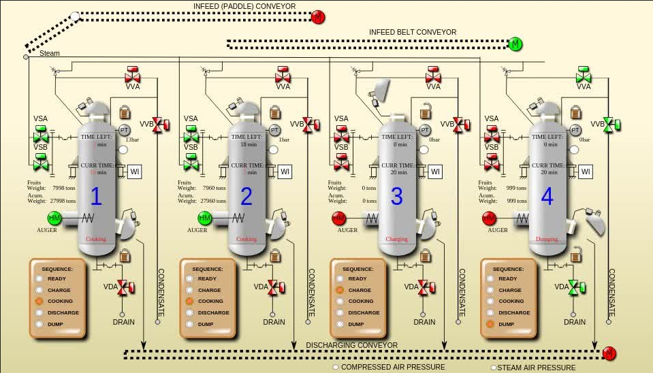
ICS History
ICS – Industrial Control System
  Made up of industrial hardware, sensors/switches, control systems and communications hardware
  Also known as
    SCADA – Supervisory Control and Data Acquisition
    DPC – Discrete Process Control
    DSC – Distributed Control System

Slide 4
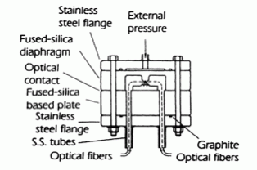


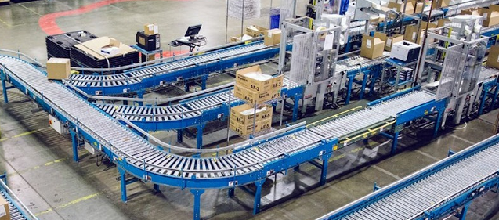
ICS History
Industrial Hardware
  Switches
  Devices
  Sensors

Slide 5
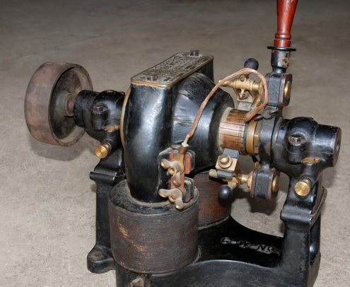

ICS History
Initially machines were operated manually
On
Off

Slide 6
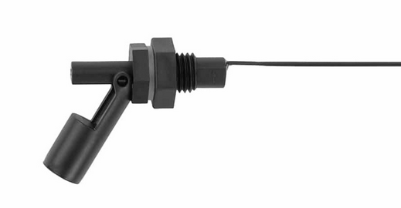
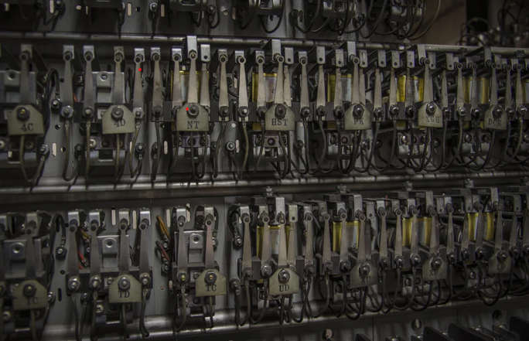
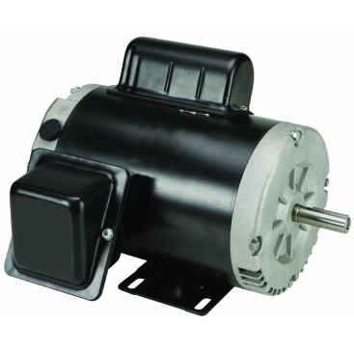
ICS History
Eventually sensors were used to control the amperage passed through a circuit and devices were turned on and off with relays
T
Tank Empty
20 mA
Pump On

Slide 7
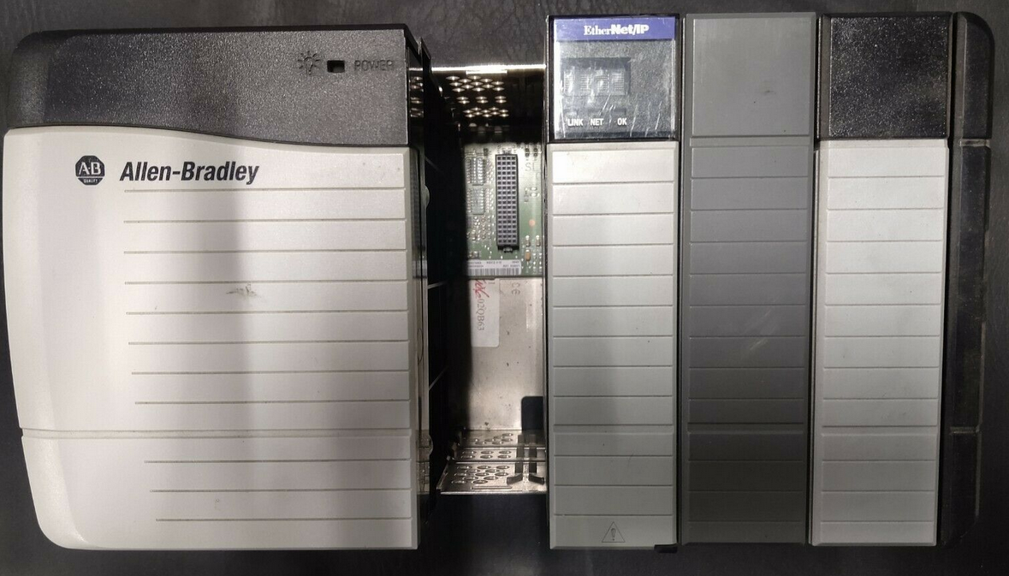
ICS History
Programmable Logic Controllers (PLC) replaced relays
T
Tank Empty
20 mA
Pump On

Slide 8
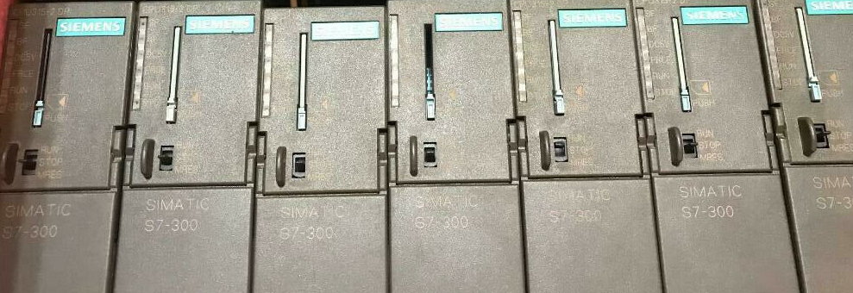
ICS History
PLC – Programmable Logic Controller

Slide 9
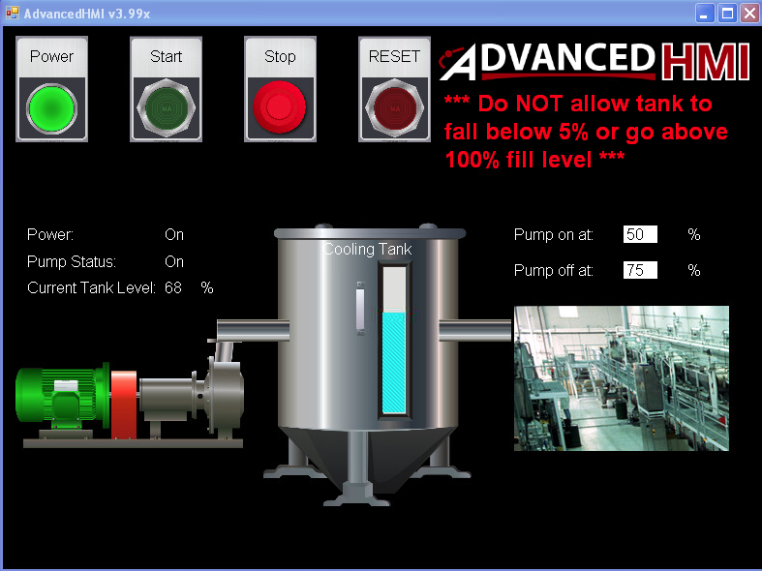
ICS History
Human Machine Interfaces (HMI) allowed operators to control PLCs and devices
T

Slide 10
ICS History
HMI – Human Machine Interface

Slide 11

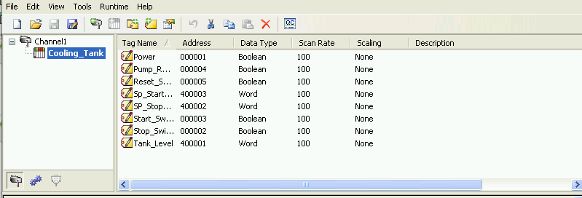
ICS History
Open Platform Communications (OPC) servers provided a standard way to integrate devices from multiple vendors
OPC Server
T
T
T

Slide 12
ICS History
OPC Servers – Open Platform Communications

Slide 13
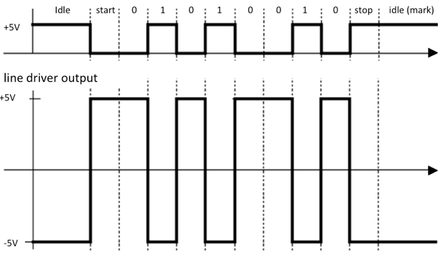
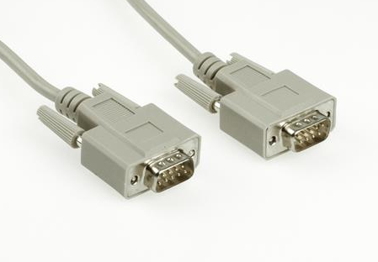
ICS History
Many methods were created to allow sensors/devices/PLCs/OPC Servers/HMI systems to communicate
  Most were proprietary
  Many were based on serial (point to point) communications

Slide 14
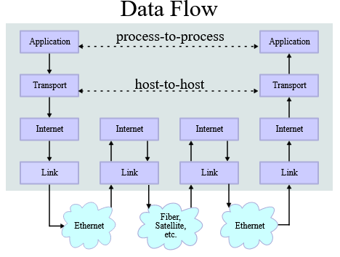
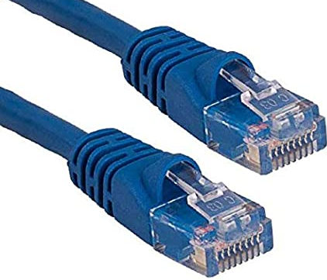
ICS History
A desire for inexpensive interoperability has driven most ICS communications to use TCP/IP over Ethernet

Slide 15
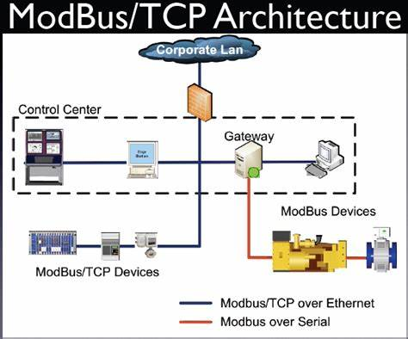
Modbus
Developed in 1979
Is a de facto standard
Openly published and royalty free
Relatively easy to deploy and maintain
Supports serial or TCP/IP communications
  Uses TCP port 502

Slide 16
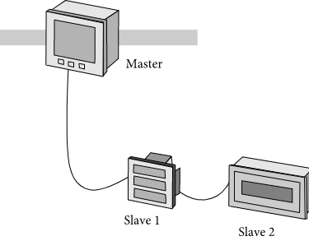
Modbus
Communication can be initiated by either the master (PULL) or the slave (PUSH)
Communication consists of query and response traffic

Slide 17
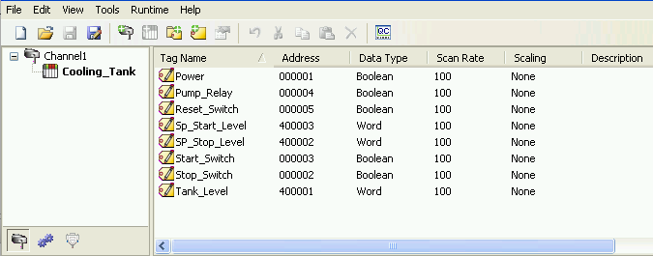
Modbus
Uses sequentially numbered 16-bit memory addresses known as registers to store data
The official documentation indicates data can be stored as bits, bytes or words

Slide 18
Modbus
Modbus defines table names which define how much information is being stored and its default register address
Storage | Access | Modbus table name | Register Address
Bit | Read-Write | Coil | 0x (00001-09999)
Bit | Read-Only | Discrete input | 1x (10001-19999)
Word | Read-Only | Input register | 3x (30001-39999)
Word | Read-Write | Holding registers | 4x (40001-49999)

Slide 19
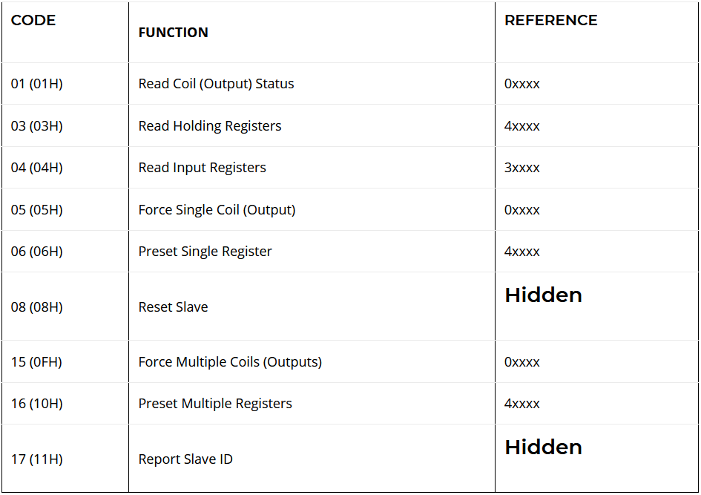
Modbus
Uses function codes in communications to describe action to be taken

Slide 20
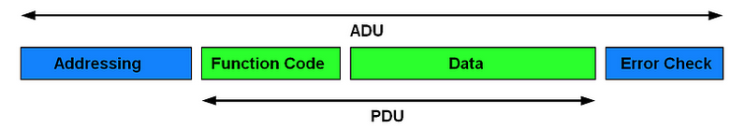
Modbus
ADU – Application Data Unit
  Entire packet including device addressing and error checking information
PDU – Protocol Data Unit
  Contains function code and data related to function such as register address/offset or bytes attached

Slide 21
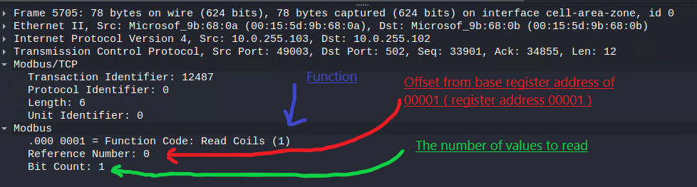
Modbus
Example read coil query
  Possibly used to determine if equipment is powered on

Slide 22
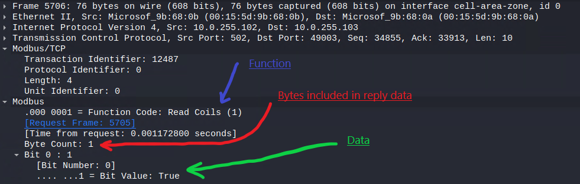
Modbus
Example read coil response
  Possibly used to determine if equipment is powered on

Slide 23

Modbus
Modbus does not support the encryption of data
Modbus has no built-in security to protect against unauthorized commands

Slide 24

PROFINET
Introduced in 2003
Originally developed by Siemens but now an open standard controlled by PROFIBUS and PROFINET International (PI)
Is an implementation of PROFIBUS used with Ethernet-TCP/IP

Slide 25
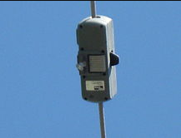
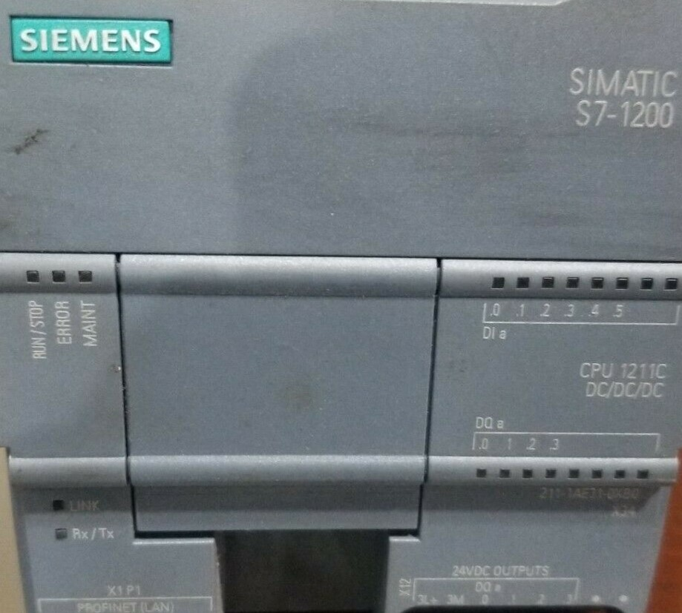
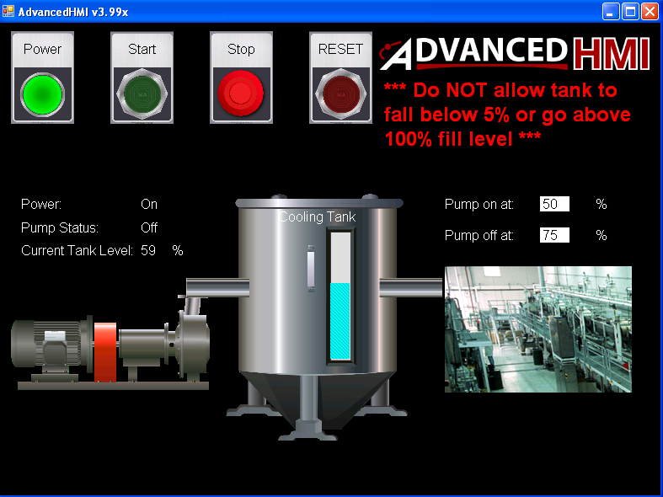
PROFINET
Uses a consumer/provider relationship where devices can be both consumers and providers
Three types of devices exist:
  IO-Devices – Sensor/Actuators
  IO-Controllers – PLC
  IO-Supervisors – HMI/Workstations

Slide 26
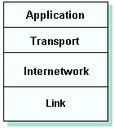
PROFINET
Defines three types of communication
  UDP/IP – Uses standard TCP/IP stack for non-critical acyclic tasks such as sending configuration data
    Acyclic – Not on a regular schedule
    Reaction times around 100 ms

Slide 27
PROFINET
Defines three types of communication
  RT – Real time communication used for cyclic communications such as sending runtime data
    Cyclic – Regularly scheduled
    Reaction time around 1 ms
    Removes the Internet and Transport layers from TCP/IP model

Slide 28
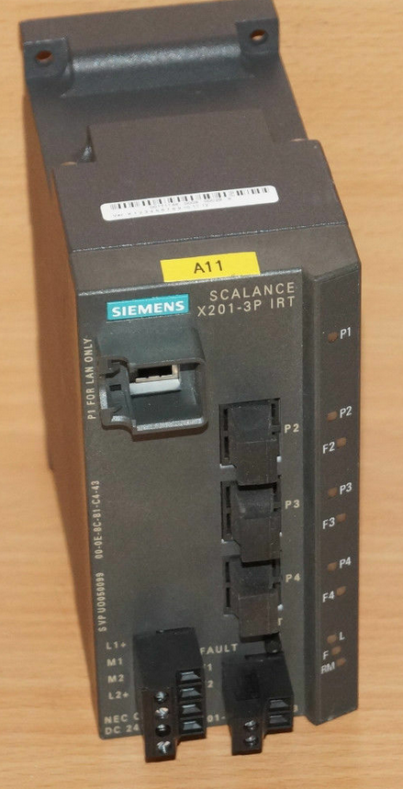
PROFINET
Defines three types of communication
  IRT – Isochronous real time communication used for extremely time sensitive communications such as with drive systems with short cycle times
    Reaction time less then 1 ms
    Assigns time slots to data transmission
    Requires special hardware

Slide 29
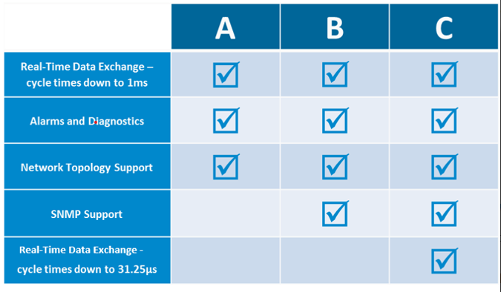
PROFINET
Defines three conformance classes that allow for easy selection of equipment
  Class A – Basic functionality
  Class B – Adds SNMP management
  Class C – Adds IRT support

Slide 30
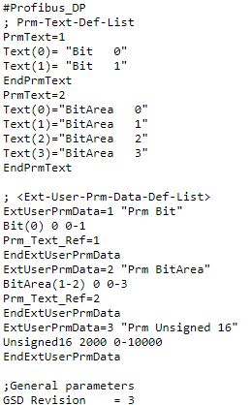
PROFINET
DAP – Device Access Point
  Created from general station description (GSD) xml formatted file provided by manufacturer
  Allow access to the device
  Used at system startup to verify device for safety purposes

Slide 31
PROFINET
Overall functionality
  Network is configured by use of the GSD xml files
  Each device is given a symbolic name that will be associated with an IP address at boot time by the dynamic configuration protocol (DCP)
  Configuration data is sent to the IO-Controller
  The IO-Controller transmits data to the IO-Devices
  Communication between the IO-Controller and IO-Device is established through an application relation (AR) made up of one or more data streams known as communication relations (CR)
  Once this has finished data transmission can begin

Slide 32
PROFINET
S7 Protocol
  Not specifically a part of PROFINET but is often used to allow supervisory devices to communicate with Siemens S7 PLC devices
  Much simpler then PROFINET
  Not well documented

Slide 33
PROFINET
S7 Protocol
  Header – Indicates the type of message
    Job Request
    Ack
    Ack-Data
    Userdata

Slide 34
PROFINET
S7 Protocol
  Uses functions to indicate action
    Data Read/Write
    Data Read/Write Cyclic
    Directory Info
    Blocks Move
    PLC Control
    System Info
    Security
    Programming

Slide 35
PROFINET
S7 Protocol
  Data addressing is made up of three components
    Memory area
      Merker (M) – Arbitrary marker variables or flags
      Data Block (DB) – Data required by operational device
      Input (I) – Device input values
      Output (Q) – Device output values
    Address – Offset from the base
    Type
      Bit
      Byte
      Word

Slide 36
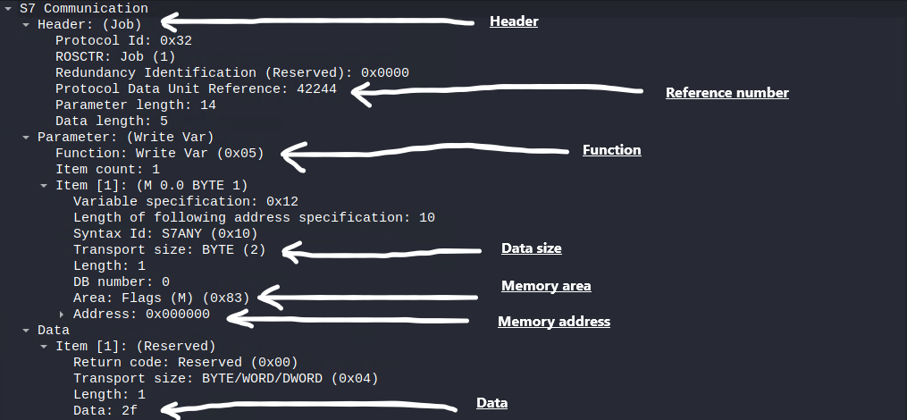
PROFINET
S7 Protocol
  Example write variable job

Slide 37
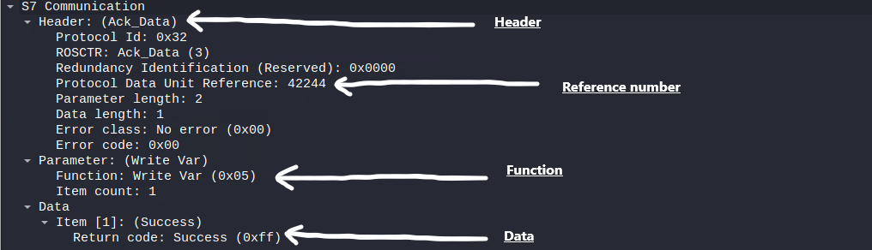
PROFINET
S7 Protocol
  Example write variable acknowledgement

Slide 38
PROFINET
PROFINET supports the encryption of data, but it is typically disabled by default and is only supported on newer devices
Many unpatched Siemens PLC devices are susceptible to Denial of Service (DOS) attacks
  ICS Advisory (ICSA-19-283-02)

Slide 39

Ethernet/IP
Developed by Rockwell Automation then taken over by the Open DeviceNet Vendors Association (ODVA)
Implements the Common Industrial Protocol (CIP) using Ethernet and TCP/IP

Slide 40
Ethernet/IP
CIP presents information as objects
Objects are made up of attributes which contain the data making up the object
Objects contain services which define actions that can be carried out on the object
  For example
    Object: Identity
      Attribute: Vender ID; Device Type; Revision; Product Name
      Services: Get_Attributes_All; Get_Attribute_Single
Identity
Revision
Device
Type
Product
Name
Set_Attributes_Single
Get_Attributes_All

Slide 41
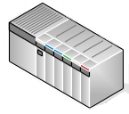
Ethernet/IP
Supports two types of communications
  Explicit communications
    Uses TCP port 44818
    Non-real time data
    Modify set-points
    Upload program code
PLC
TCP
Workstation

Slide 42

Ethernet/IP
Supports two types of communications
  Implicit communications
    Uses UDP port 2222
    Real time data
    Periodic data exchange
PLC
UDP
Sensor

Slide 43
Ethernet/IP
Ethernet/IP does not encryption data by default
  Can be secured by implementing Secure Transport for Ethernet/IP
Older unpatched Rockwell AB PLC devices are susceptible to Denial of Service (DOS) attacks
  ICS Advisory (ICSA-13-011-03)

Slide 44
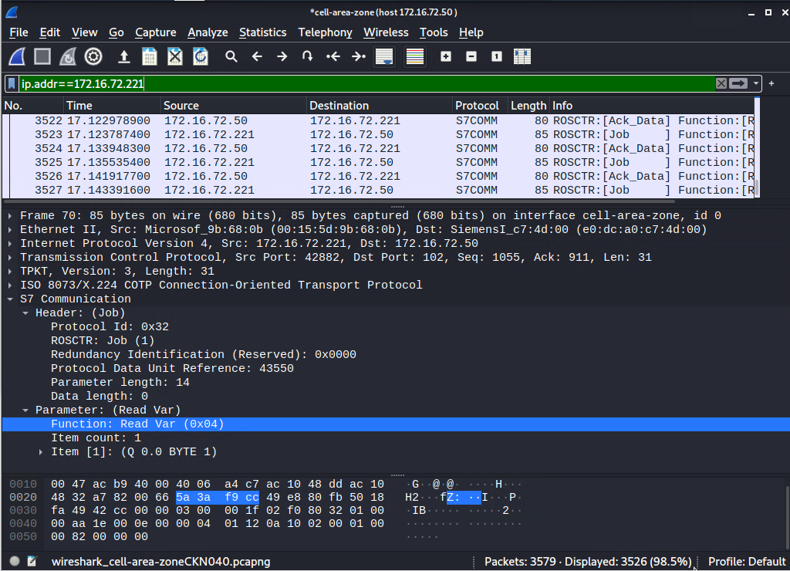

Security Tools
Wireshark
  Allows the monitoring of network traffic

Slide 45
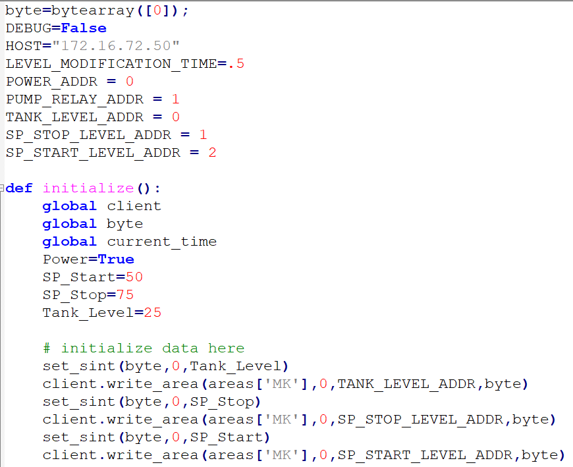

Security Tools
Python
  Can be used with open-source modules to create custom code which can be used to communicate with industrial devices

Slide 46
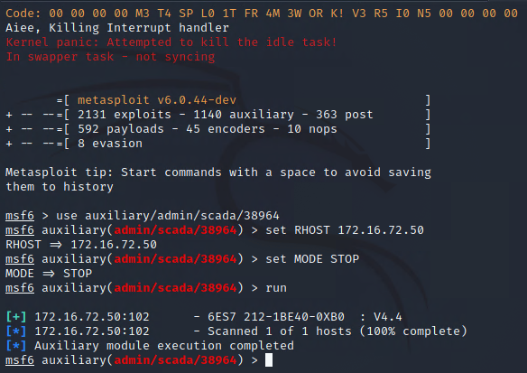

Security Tools
Metasploit
  A security tool which contains various modules which can be used to test security on industrial devices

Slide 47
For More Information
For further information go to https://www.nl.northweststate.edu/camo or contact:
  Tony Hills – thills@northweststate.edu – 419-267-1354
  Sarah Stubblefield – sstubblefield@northweststate.edu – 419-267-1512
  Mike Kwiatkowski – mkwiatkowski@northweststate.edu – 419-267-1231
Made possible through support from the National Science Foundation (NSF) award number 1800929

