Slide 1




Metasploit Basics
Made possible through support from the National Science Foundation (NSF) award number 1800929

Slide 2
Objectives
Explain Metasploit’s Purpose.
Define Metasploit Terminology.
Discuss Basic Metasploit Usage.
Demonstrate Basic Metasploit Usage.

Slide 3

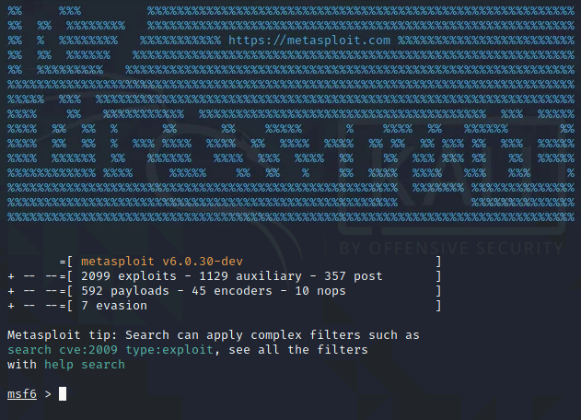
Metasploit Overview
Metasploit is a Ruby based, open-source framework designed to provide a consistent and easily expandable way to use security tools and exploits
  Used by black and white hat security professionals
    This tool should NOT be used in a production environment!

Slide 4



Metasploit Terminology
Vulnerability – A security flaw in software or hardware that may be susceptible to exploitation.
Exploit – The act of taking advantage of a vulnerability.
Payload – The module that will execute when the exploit is successful.

Slide 5
Basic Metasploit Process
Find Vulnerability
Load Module
Set Options
Select Payload
Set Options
Exploit

Slide 6
Find Vulnerability
Metasploit is primarily designed to exploit, not find, vulnerabilities
Metasploit contains tools that can be used to discover systems and vulnerabilities
  db_nmap
    Version of nmap that saves results to a database
  Connect
    Built in ncat program
Metasploit is designed to interface with a database to allow you to save your work
Metasploit passes any commands it doesn’t recognize to the local operating system

Slide 7
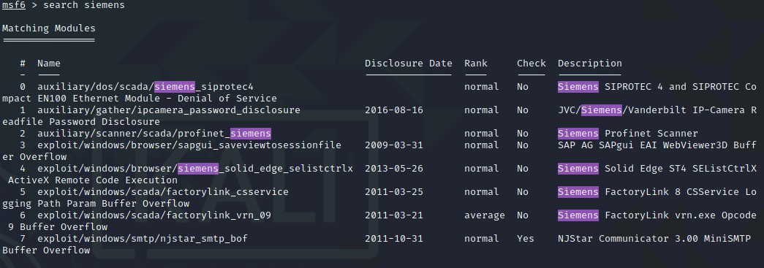
Load Module
Modules are Ruby scripts that plug into then extend Metasploit's functionality
Exploits are modules that use payloads
Search is a useful command used to locate available modules

Slide 8
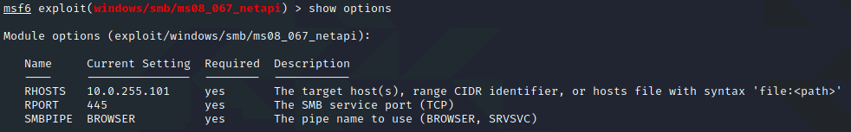
Exploit Options
Options control what and how Metasploit module's function
Common module options:
  RHOSTS – Remote host (the host being targeted)
  RPORT – Remote port (the port being targeted)

Slide 9
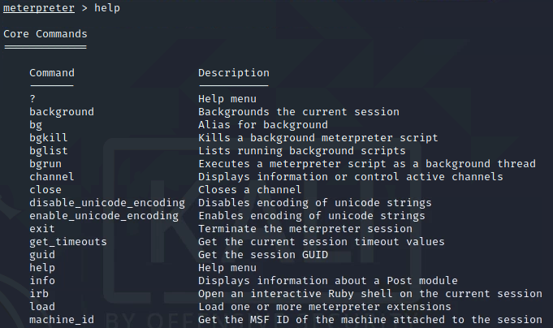
Payload Type
There are many types of payloads
  bind – Establish a connection from the local system to the remote system
  reverse_bind – Establish a connection from the remote system to the local system
    Normally used when a firewall prevents direct access to the remote system
  meterpreter – Fileless shell replacement software for Windows (uses dll injection)

Slide 10
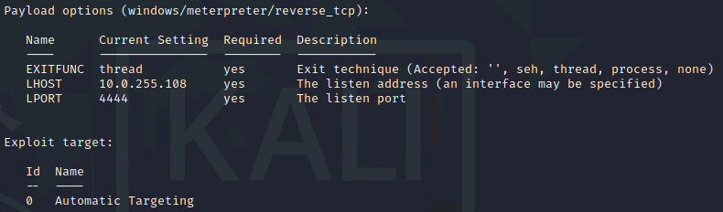
Payload Options
Options control what and how Metasploit payload’s function
Common module options:
  LHOST – Local host (the host performing the attack)
  LPORT – Local port (the port on the local system that will accept the connection from the target)

Slide 11
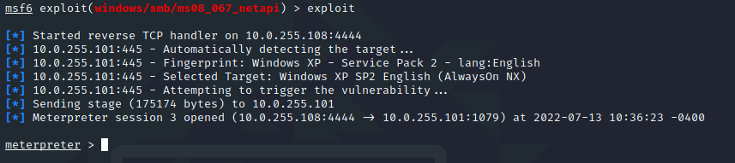
Exploit the Target
Once the module is loaded, the payload selected, and the options set type exploit or run to activate the module

Slide 12
For More Information
For further information go to https://www.nl.northweststate.edu/camo or contact:
  Tony Hills – thills@northweststate.edu – 419-267-1354
  Mike Kwiatkowski – mkwiatkowski@northweststate.edu – 419-267-1231
Made possible through support from the National Science Foundation (NSF) award number 1800929

