Slide 1




Secure Remote ICS Access Using a VPN and Firewall
Made possible through support from the National Science Foundation (NSF) award number 1800929

Slide 2
Objectives
Explain basic firewall concepts.
Explain basic Virtual Private Network (VPN) concepts.
Compare different VPN technologies.
Demonstrate how the use of a firewall can prevent many remote attacks.
Demonstrate how the use of VPN secures network traffic.

Slide 3
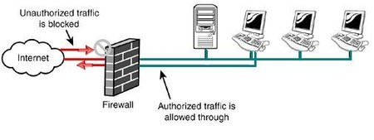
Firewall Basics
The purpose of a firewall is to allow authorized traffic and prevent unauthorized traffic
  Typically, outbound traffic is mostly unrestricted while inbound traffic is severely restricted

Slide 4



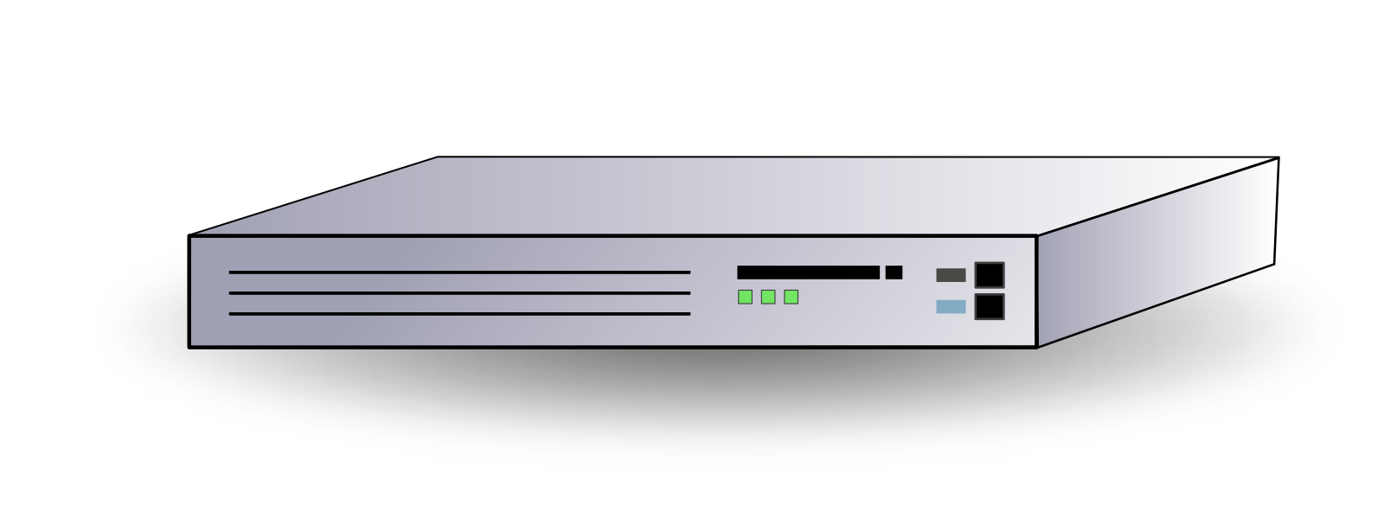

Firewall Basics
Firewalls can be broadly classified into two categories
  Host based firewalls protect a single host
  Network based firewalls protect all systems on the same network segment
Network Firewall
Host Firewall

Slide 5
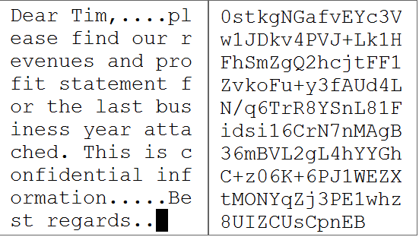
VPN Basics
VPN – Virtual Private Network
  Creates a private tunnel by encrypting data prior to sending it and decrypting the data when it is received
No VPN
Unencrypted data transmitted
VPN
Data encrypted before
being transmitted

Slide 6
VPN Basics
Internet
Plain text
Cypher text
Secret recipe
------
12 something
2 other stuff
Encrypt
ziwksmsfveo
ynonfeyqvcx
Dbjxyplowgj
xmelqjtoczs
Encapsulatee
Network Tunnel
Cypher text
Sender

Slide 7

VPN Basics
Internet
Cypher text
Plain text
Network Tunnel
Decapsulate
ziwksmsfveo
ynonfeyqvcx
Dbjxyplowgj
xmelqjtoczs
Decrypt
Secret recipe
------
12 something
2 other stuff
Cypher text
Receiver
Hacker

Slide 8
VPN Technologies
PPTP - Point to Point Tunneling Protocol
  Simple to setup
  Not secure
L2TP – Layer 2 Tunneling Protocol/IPSec – IP Security
  L2TP – Provides basic unsecured tunneling
  IPSec – Secures the data in the L2TP tunnel

Slide 9
VPN Technologies
SSTP - Secure Socket Tunneling Protocol
  Uses SSL/TLS over TCP port 443 which prevents many firewall issues
OpenVPN
  Open source VPN solution which is often implemented using Linux
Other
  Many other VPN solutions exist including commonly used proprietary solutions from vendors such as Cisco

Slide 10
For More Information
For further information go to https://www.nl.northweststate.edu/camo or contact:
  Tony Hills – thills@northweststate.edu – 419-267-1354
  Mike Kwiatkowski – mkwiatkowski@northweststate.edu – 419-267-1231
Made possible through support from the National Science Foundation (NSF) award number 1800929

