Slide 1
Packet Capture Using Wireshark
Made possible through support from the National Science Foundation (NSF) award number 1800929

Slide 2
Objectives
Discuss the purpose of packet capture software such as Wireshark.
Use Wireshark to capture network data.
Explain the different ways Wireshark can present and format captured data.
Control the display and capture of network data using filters.
Discuss various ways networks and network devices can be manipulated to allow the capture of network traffic.

Slide 3
Wireshark Overview
What is Wireshark?
Wireshark is software that allows us to view all data being transmitted on a network
Wireshark allows us to view fully decoded data or view data in its raw (binary) format
Wireshark is free, open-source software
Wireshark is available for multiple platforms (Linux, MAC, Windows)
https://www.wireshark.org

Slide 4
Wireshark Simple Usage
Download and install
Needs to be run as the super-user or permissions need to be configured to allow regular user access

Slide 5
Wireshark Simple Usage
Select the interface to be used to capture the data

Slide 6
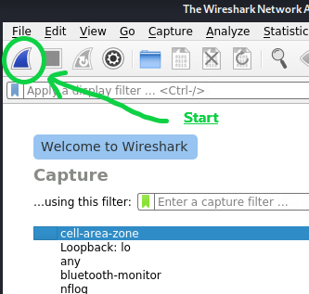
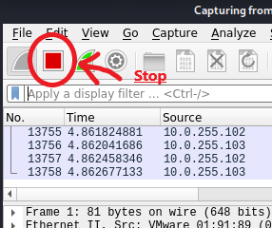
Wireshark Simple Usage
Click the Start button to begin capture
Click the Stop button to end capture

Slide 7
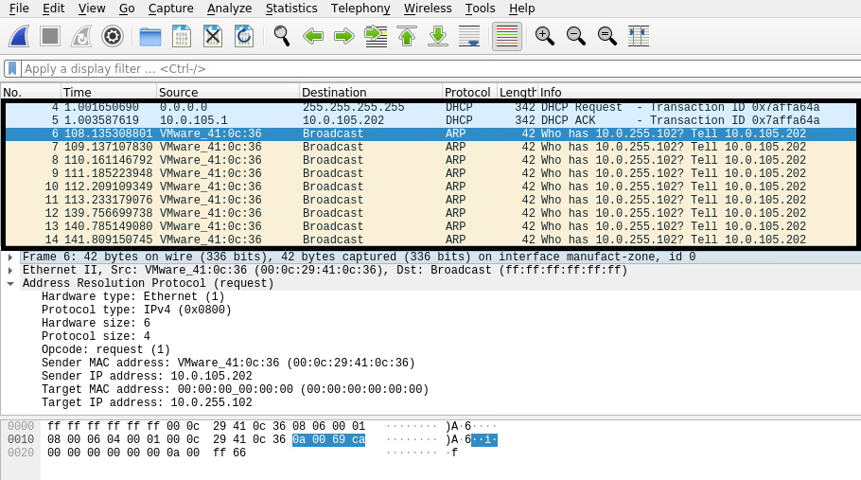
Wireshark Screen Layout
When viewing a packet capture, the Wireshark screen is divided into three sections
The top pane (packet list) shows an ordered list containing a summary of each packet captured

Slide 8
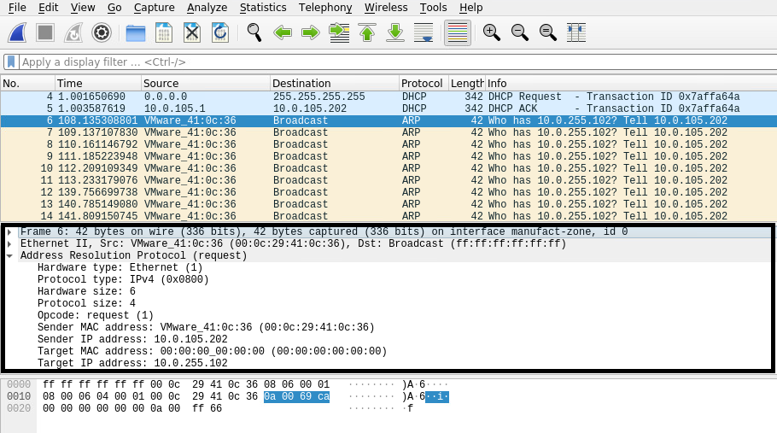
Wireshark Screen Layout
When viewing a packet capture, the Wireshark screen is divided into three sections
The middle pane (packet details) shows detailed and decoded data associated with the packet selected in the packet list pane
Some summary data listed in the packet details pane can be expanded to provide more detailed information about the section of the packet being displayed

Slide 9
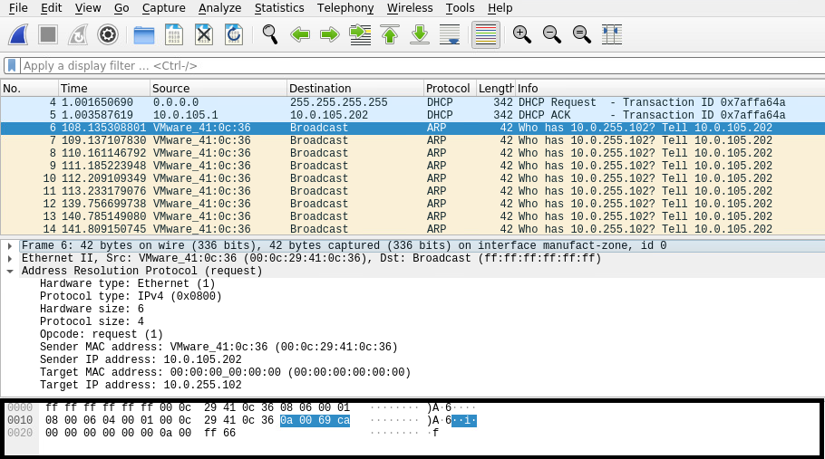
Wireshark Screen Layout
When viewing a packet capture, the Wireshark screen is divided into three sections
The bottom pane (packet bytes) shows the raw (binary) data associated with the packet selected in the packet list pane
If any decoded data is selected in the packet details pane the associated raw data will be highlighted in the packet bytes pane

Slide 10
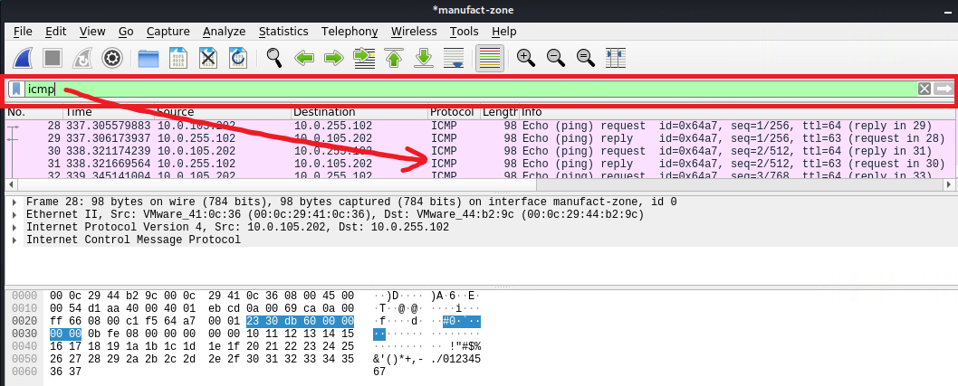
Wireshark Filters
Wireshark display filters can be typed into the filter toolbar to limit the data displayed and make it easier to view only specific packets

Slide 11
Wireshark Filters
Here are some example and commonly used display filters
Filter | Purpose
Protocol name (i.e. dhcp, icmp, telnet) | Display only data from packets which implement a specific protocol
ip.addr == 192.168.1.1 | Display only data coming from or going to the IP address 192.168.1.1
ip.src == 10.0.255.10 and ip.dst == 10.0.105.202 | Display only data coming from the IP address 10.0.255.10 AND going to the IP address 10.0.105.202
For more information see https://wiki.wireshark.org/DisplayFilters

Slide 12
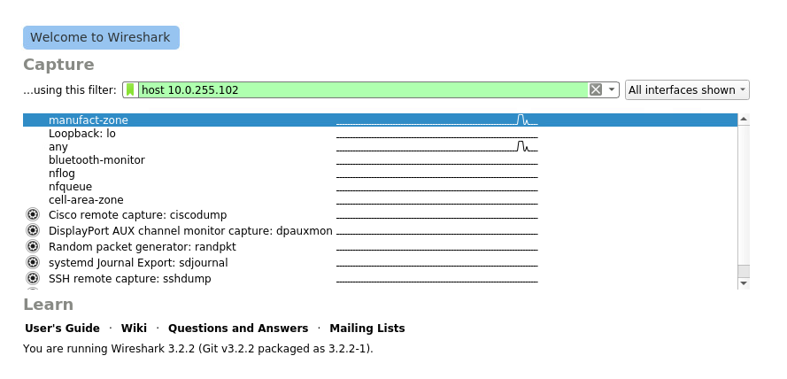
Wireshark Filters
Wireshark also supports capture filters which can be applied prior to starting the data capture
Wireshark capture filters limit the data before capture while display filters limit the amount data display after capture

Slide 13
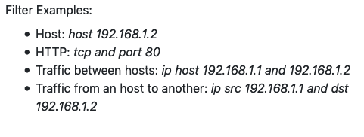
Wireshark Filters
Wireshark capture filters use a different syntax then display filters
Wireshark capture filters use the pcap-filter syntax which is used by other network monitoring software packages such as the command line tcpdump program found on many Linux and Unix based systems
For more information see https://wiki.wireshark.org/CaptureFilters

Slide 14
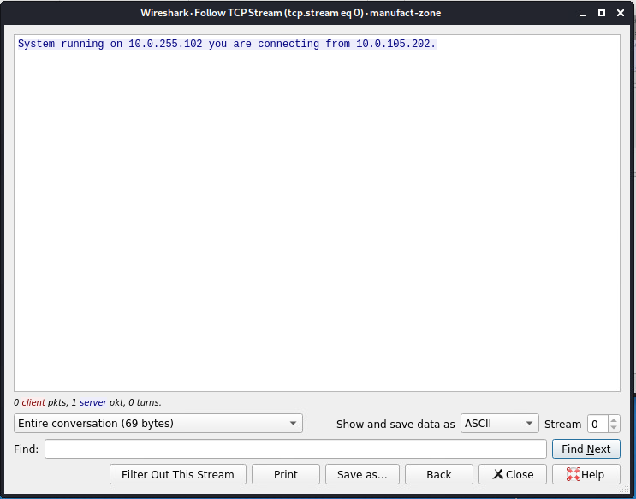
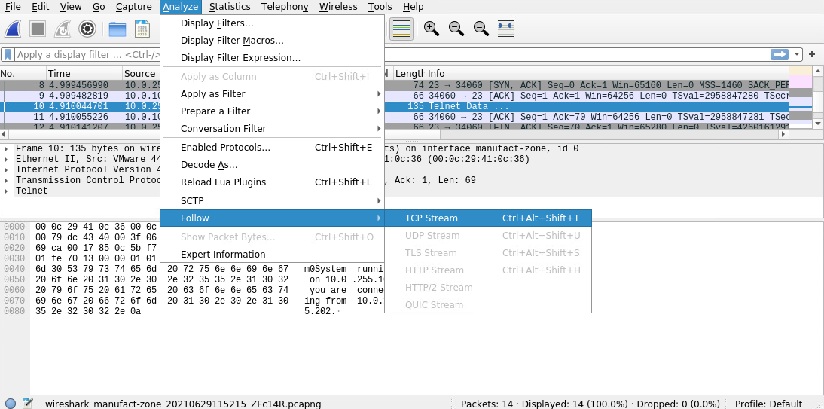
Wireshark Follow Stream
Wireshark has the capability to combine all the packets in a protocol stream together then display them on a single screen in several different formats

Slide 15
Wireshark Packet Files
Wireshark has the ability open, decode and analyze data saved in a wide variety of formats for example:
Wireshark’s native format is libpcap which can be generated by many programs and network devices
Microsoft Network Monitor captures
Oracle snoop and atmsnoop captures
Novell LANalyzer captures
pppd log files
IBM OS/400 communication traces
MPEG-2 transport streams

Slide 16
Wireshark Capture Problems
Network interface cards (NIC) are designed to process network traffic addressed to themselves and discard all other network traffic
Accepted:
AE:90:01:02:FA:12
To: AE:90:01:02:FA:12
To: 44:92:01:88:FA:02
AE:90:01:02:FA:12
NIC
Ignored:
44:92:01:88:FA:02

Slide 17
Wireshark Capture Problems
To resolve this, some, but not all, network interface cards (NIC) can be configured to accept all traffic
Ethernet network cards may support promiscuous mode
Wireless network cards may support monitor mode
Accepted:
AE:90:01:02:FA:12
To: AE:90:01:02:FA:12
Accepted:
44:92:01:88:FA:02
To: 44:92:01:88:FA:02
AE:90:01:02:FA:12
NIC
(Promiscuous)

Slide 18
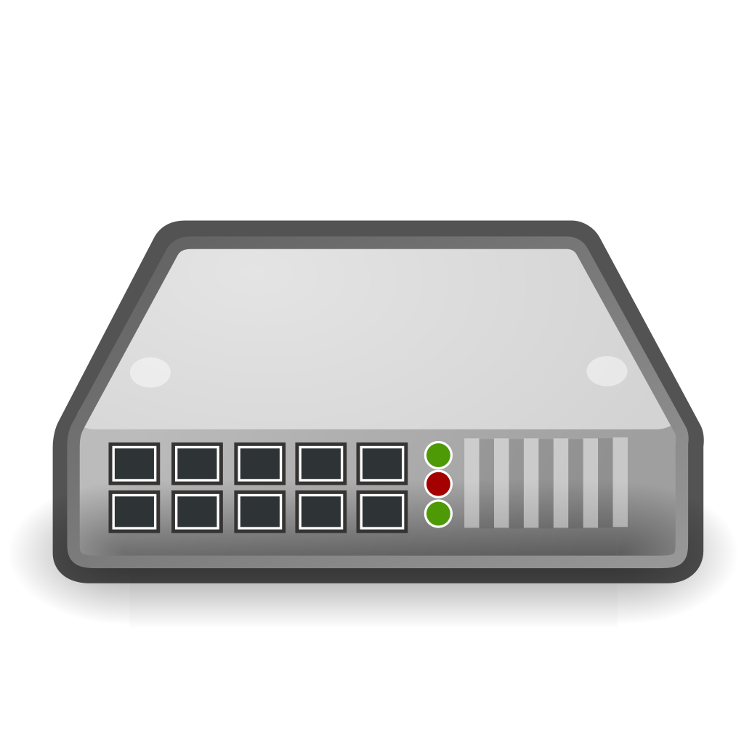
Wireshark Capture Problems
Network switches are designed to learn the addresses of systems connected to each port and store that information in a MAC address table
Port | Address
1 | AE:90:01:02:FA:12
2 | 44:92:01:88:FA:02
3 | None
4 | None
5 | None
6 | None
7 | None
8 | None
9 | 25:66:43:B5:92:01
10 | 30:9C:23:9D:7B:19
AE:90:01:02:FA:12
25:66:43:B5:92:01
44:92:01:88:FA:02
30:9C:23:9D:7B:19

Slide 19
Wireshark Capture Problems
Traffic is then forwarded out only on the port containing the system with the proper destination address
Traffic from 192.168.1.101 to 192.168.1.109 would only be seen on ports 1 and 9
Port | Address
1 | AE:90:01:02:FA:12
2 | 44:92:01:88:FA:02
3 | None
4 | None
5 | None
6 | None
7 | None
8 | None
9 | 25:66:43:B5:92:01
10 | 30:9C:23:9D:7B:19
AE:90:01:02:FA:12
25:66:43:B5:92:01
Src: AE:90:01:02:FA:12
Dst: 25:66:43:B5:92:01
Src: AE:90:01:02:FA:12
Dst: 25:66:43:B5:92:01
44:92:01:88:FA:02
30:9C:23:9D:7B:19

Slide 20
Wireshark Capture Problems
There are multiple ways to resolve this, the following methods are often used by network administrators to legally monitor network traffic
Many network switches provide a feature that can be configured to mirror traffic from one another monitor port
Devices called network taps can be purchased and inserted into network where the tap will copy all traffic received onto a monitor port

Slide 21
Wireshark Capture Problems
There are multiple ways to resolve this, the following methods are used by hackers to illegally monitor network traffic
Some switches MAC tables can be overloaded which will cause it to forward traffic out on all ports
A technique known as ARP spoofing can fool the switch into thinking a port contains an address it does not

Slide 22
For More Information
For further information go to https://www.nl.northweststate.edu/camo or contact:
Tony Hills – thills@northweststate.edu – 419-267-1354
Sarah Stubblefield – sstubblefield@northweststate.edu – 419-267-1512
Mike Kwiatkowski – mkwiatkowski@northweststate.edu – 419-267-1231
Made possible through support from the National Science Foundation (NSF) award number 1800929

