Slide 1
System Hardening Basics
Made possible through support from the National Science Foundation (NSF) award number 1800929

Slide 2
Objectives
Discuss System Hardening
Examine Good Password Hygiene.
Demonstrate the Importance of Applying Software Patches.
Disable Unnecessary System Services.
Discuss and Enable Local System Security Software.

Slide 3
What is System Hardening
System hardening simply means implementing best practices and practicing good security hygiene
System hardening can make even old, obsolete and inherently insecure systems more secure
Failure to harden a system can make even the newest, inherently secure systems very insecure

Slide 4
Why Choose Good Passwords
Alibaba attack
Alibaba is a giant Chinese technology company offering services like eBay, Amazon, PayPal and others.
Hackers performed password attacks using a database of 99 million usernames
Hackers successfully compromised 1 in 5 which is approximately 21 million accounts

Slide 5
Poor Password Hygiene
ag6tb
Poor password choices?
Short passwords
Dictionary words
Personal data
Recycled password
secretpassword
Ms.Nibbles
Passwords
Notes:
This is a good place to get audience participation.

Slide 6
Passphrases
Passphrase – A combination of several words or parts of words
Don’t choose common phrases
Use phrases that you can easily remember
Include punctuation and spaces
Convert some letters to numbers
Use only some characters from each word
ICSTrainingFunInJuly
ICS Training Fun In July!
I3S Training Fun 1n July!
I3TrFu1nJu!

Slide 7
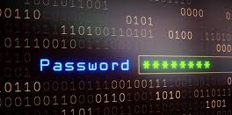
Multifactor Authentication (MFA)
MFA – To combine different types of authentication
Things you know
Things you have
Things you are

Slide 8
Password Managers - Convenient
Browser based password managers
Convenient
Are likely accessible by anyone who can gain console access to the browser
Are likely accessible by malware running on computer
Can set a “master” password in Firefox and Edge but not Chrome

Slide 9
Password Managers - Full Featured
LastPass
Free account has severe limitations
Only a single device type supports (mobile or computer)
Has been compromised several times
KeePass
Secure, lightweight, open-source password manager
Offline only
Bitwarden
Free version is fairly comprehensive

Slide 10
Why Apply Patches
Equifax attack
Equifax is one of the three consumer credit reporting agencies in the United States
Hackers took advantage of a previously reported but unpatched vulnerability in Apache Struts to gain access
Apache Structs is software used to create and manage web sites
143 million records were compromised and many of those had never directly used Equifax

Slide 11
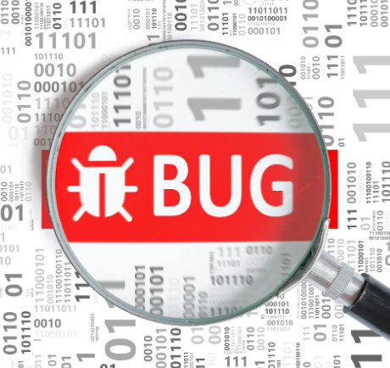
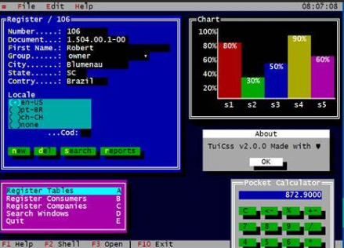
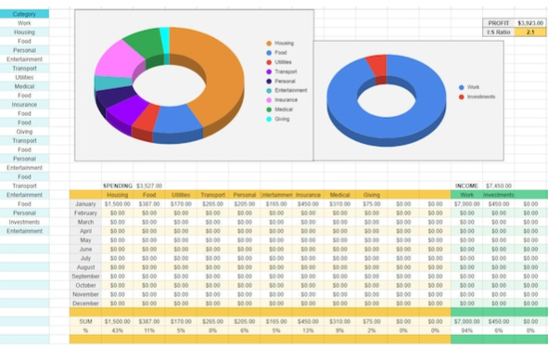
What are Patches
What is a patch?
Often used to fix problems discovered after release.
Sometimes used to add functionality.

Slide 12
Why Are Patches Not Applied
Patching can be time consuming
Sometimes system reboots are necessary meaning they must be applied outside regular business hours
Sometimes patching cannot be automated
Many IT departments are understaffed
Patches can break things
It can be difficult to know when patches are available
Patches are not available for end-of-life products

Slide 13
Patching Best Practices
Maintain system and software inventory
Test Patches
Automate where possible
Consider a patch management solution like Windows Software Update Service (WSUS)
Create a rollback plan in case patching breaks things

Slide 14
Why Disable Unnecessary Services
Equifax attack
Apache Struts was not needed on the servers that were initially attacked

Slide 15
Unnecessary Services
Disabling unnecessary services:
Reduces the attack surface of systems which improves security
Improves system performance
Simplifies patch management
Should be done cautiously and with extensive testing to make sure critical services are not accidently disabled

Slide 16
Why Enable Local Security Software
Colonial Pipeline Attack
Colonial pipeline is the largest pipeline system for refined oil in the United States
It is possible that this attack may have originated through a phishing attack
The attack may have stolen login credentials
The attack may have installed malware that installed a local backdoor
Properly installed, configured and updated antivirus software will stop many malware programs
Properly installed, configured and updated host-based firewalls will stop many backdoor programs
Caused fuel shortages, higher prices and panic for several day

Slide 17
Local Security Software
Anti-virus
Anti-virus software should be installed, configured and regularly updated on individual host machines
Host based firewalls
Host based firewalls should be installed, configured and regularly updated on individual host machines
Logging
Logging should be enabled on host machines to make troubleshooting and forensic analysis easier

Slide 18
Summary
Examine Good Password Hygiene.
Demonstrate the Importance of Applying Software Patches.
Disable Unnecessary System Services.
Discuss and Enable Local System Security Software.

Slide 19
For More Information
For further information go to https://www.nl.northweststate.edu/camo or contact:
Tony Hills – thills@northweststate.edu – 419-267-1354
Mike Kwiatkowski – mkwiatkowski@northweststate.edu – 419-267-1231
Made possible through support from the National Science Foundation (NSF) award number 1800929

